Slide 1
Content Aggregator App
By Gareth Wilson

Slide 2
Task
A Kanban/Trello board outlining the required tasks of the project
Risk Assessment document
Requirement Gathering
Detailed Process Description (DPD)
RPA Solution using UiPath

Slide 3
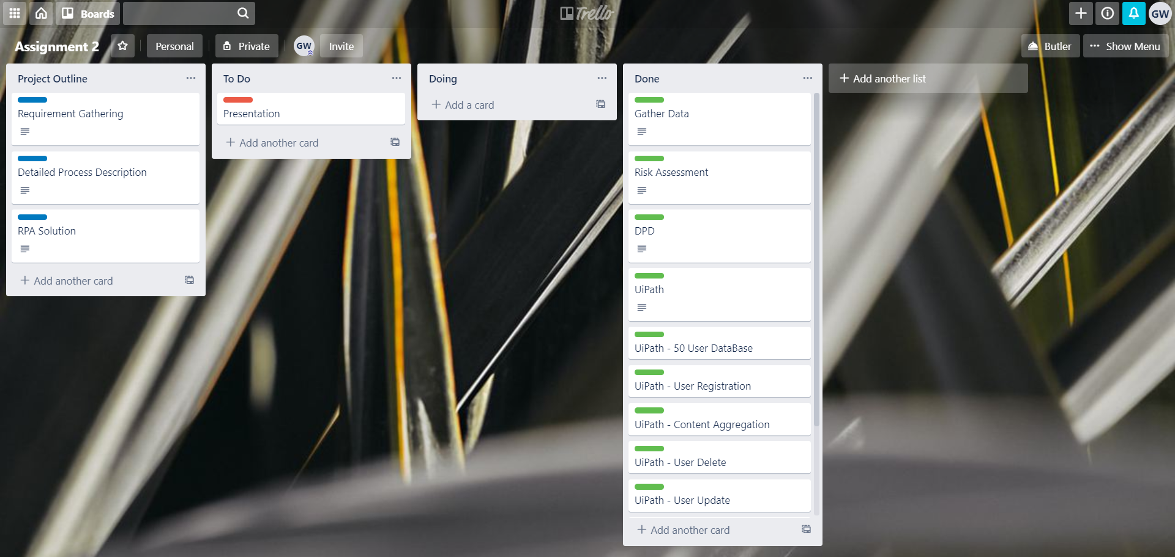
Trello Board
Created Trello board to track tasks
Trello board contains -
Three colour coordinated lists
Cards detailing the tasks required

Slide 4
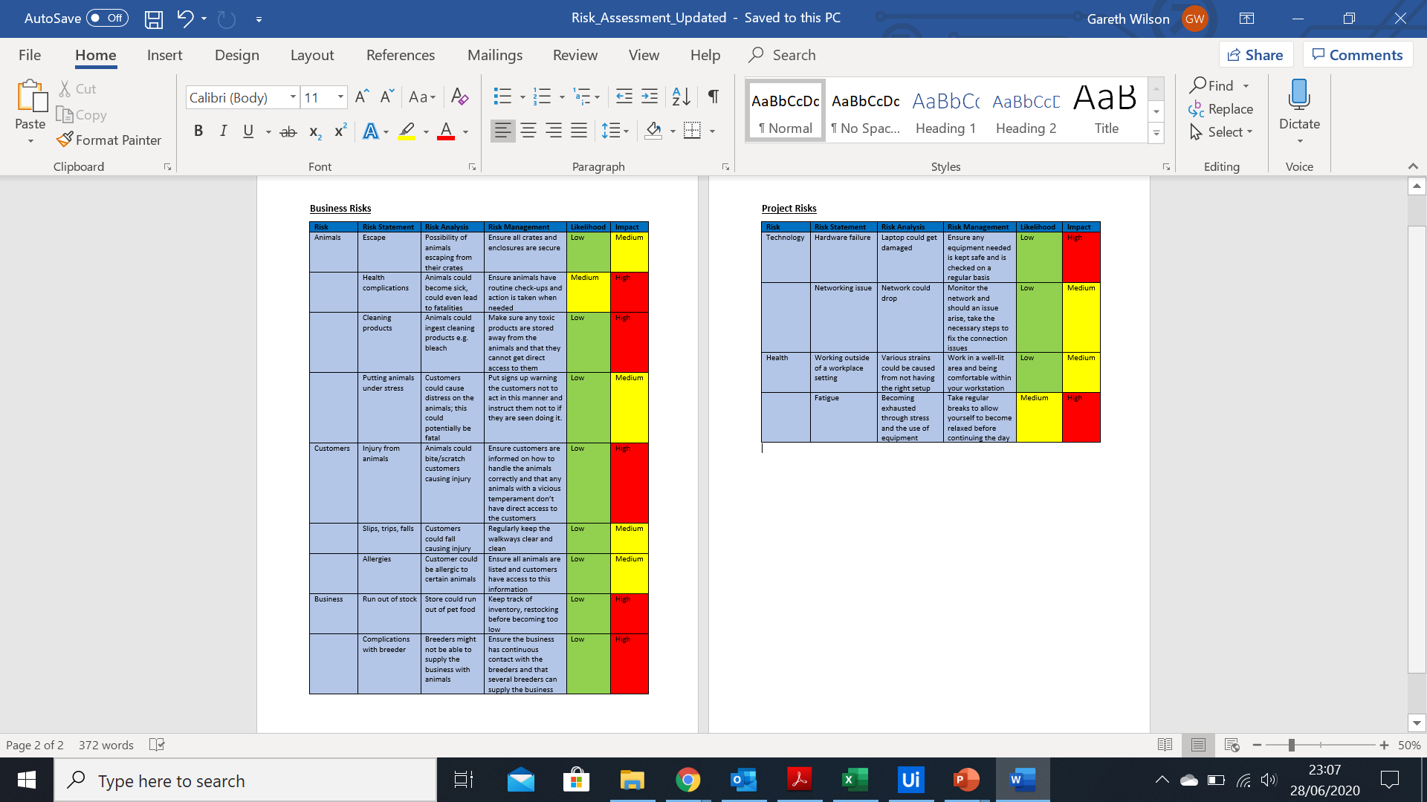
Risk Assessment
Two risk assessments created outlining the potential threats surrounding the project
Business Risk Assessment
Project Risk Assessment

Slide 5
Detailed Process Description (DPD)
Outlines -
The current manual process
The automation proposal and benefits
Automation details

Slide 6
RPA Solution
Fake Database
Imitating Tobor Inc.’s internal database
User Journey
Registering, Updating, Deleting
Content Aggregator
Data collected from 3 sites per content preference
Content tidied and sent to the relevant user
Daily Report
Outlines the user requests from that day
Outlines the transactions made to the users

Slide 7
Reflection
What went well:
Improving my understanding of the RPA process
E.g. DPD, Data Gathering, ect.
Issues:
Time Constraints
A few blockers throughout the process
Future Improvements:
One main workflow
More exception handling
Triggers
Set up for interval timings

